Slide 1
FORGING YOUR FUTURE
U.S. NAVY SUBMARINE INDUSTRIAL BASE

Slide 2
THE MISSION

Slide 3
Demand for Ships
“The Navy’s role in defending our nation and promoting peace has never been more expansive or mattered more.”
— Lt. Kyle Hanton, spokesperson for the U.S. Secretary of the Navy
Nuclear Deterrence of Aggression
  Enable our crucial second-strike
  deterrent to prevent aggression
Need to Ensure Global Security
  Guarantee freedom of the seas, deter
  regional conflict, and yield innovation
Supply, Meet Demand
  Production must double for at least the next ten years

Slide 4
Mission of the Submarine Industrial Base
Focus on the Vital Role
of Maritime Security
  70% of the U.S. nuclear
  arsenal is underwater
  in submarines
  The next generation of frigates
  will be able to conduct air,
  anti-submarine, surface, and electromagnetic warfare
  DDG(X) Destroyers will have longer-range strike capabilities
  and directed-energy weapons.
Helping Manufacturers
Across America
  Workforce development,
  supply chain resilience, and advanced technologies
  Need to build the next
  generation of naval vessels
  New class of ships pose project management challenges
Addressing the
Challenges
  Decline of the U.S. manufacturing base culminating in overdue
  builds and repairs
  Most submarines have
  exceeded their 35-year
  lifespan by 7+ span
  Need to increase the maritime manufacturing workforce
  by nearly 200,000 new workers
  by the year 2028

Slide 5
SIB’s Lines of Effort
Supplier Development
Targeted investments to support suppliers of sequence critical material and improve critical supplier performance and resiliency
  Focused on adding capability and/or capacity to existing suppliers, develop new suppliers to reduce sole-source risks for resiliency, and improve first-time quality
  Continuous assessment of supply chain health, through risk monitoring and demand signal modeling that provides an active site-picture across Navy shipbuilding portfolios
Advanced Manufacturing
  Working to rapidly advance additive manufacturing (AM) and Industry 4.0 technologies to reduce delays in shipbuilding and maintenance, especially in fragile areas like castings and forgings – saving over 900 days to date
  AM Center of Excellence in Danville, VA is driving production-ready AM adoption, with 70+ active projects, support from 60+ suppliers, and successful installation of 15+ AM parts on Navy vessels
  Training the future of AM workforce through ATDM and deploying digital solutions – like automated inspection and robotics – to improve quality, speed, and readiness across the industrial base
Workforce Development
  Must hire ~25,000 workers annually – over 250,000 in the next decade – to sustain shipbuilding and repair, amid an aging workforce and a shrinking manufacturing sector
  Launched 150+ initiatives, including ATDM, six regional pipelines, and expanded trade school and university partnerships, training thousands of students.
  Through BuildSubmarines.com and large-scale marketing efforts, SIB has attracted 2.3M+ job seekers across the country
  Reached 50K K-12 students across
  30 states to grow interest in
  maritime careers

Slide 6
Every year for 10 years starting in 2028, we must…
1 Columbia-class Submarine
2 Virginia-class Submarines
Sustainment & Maintenance

Slide 7
Why do you think
submarines are
so important?

Slide 8
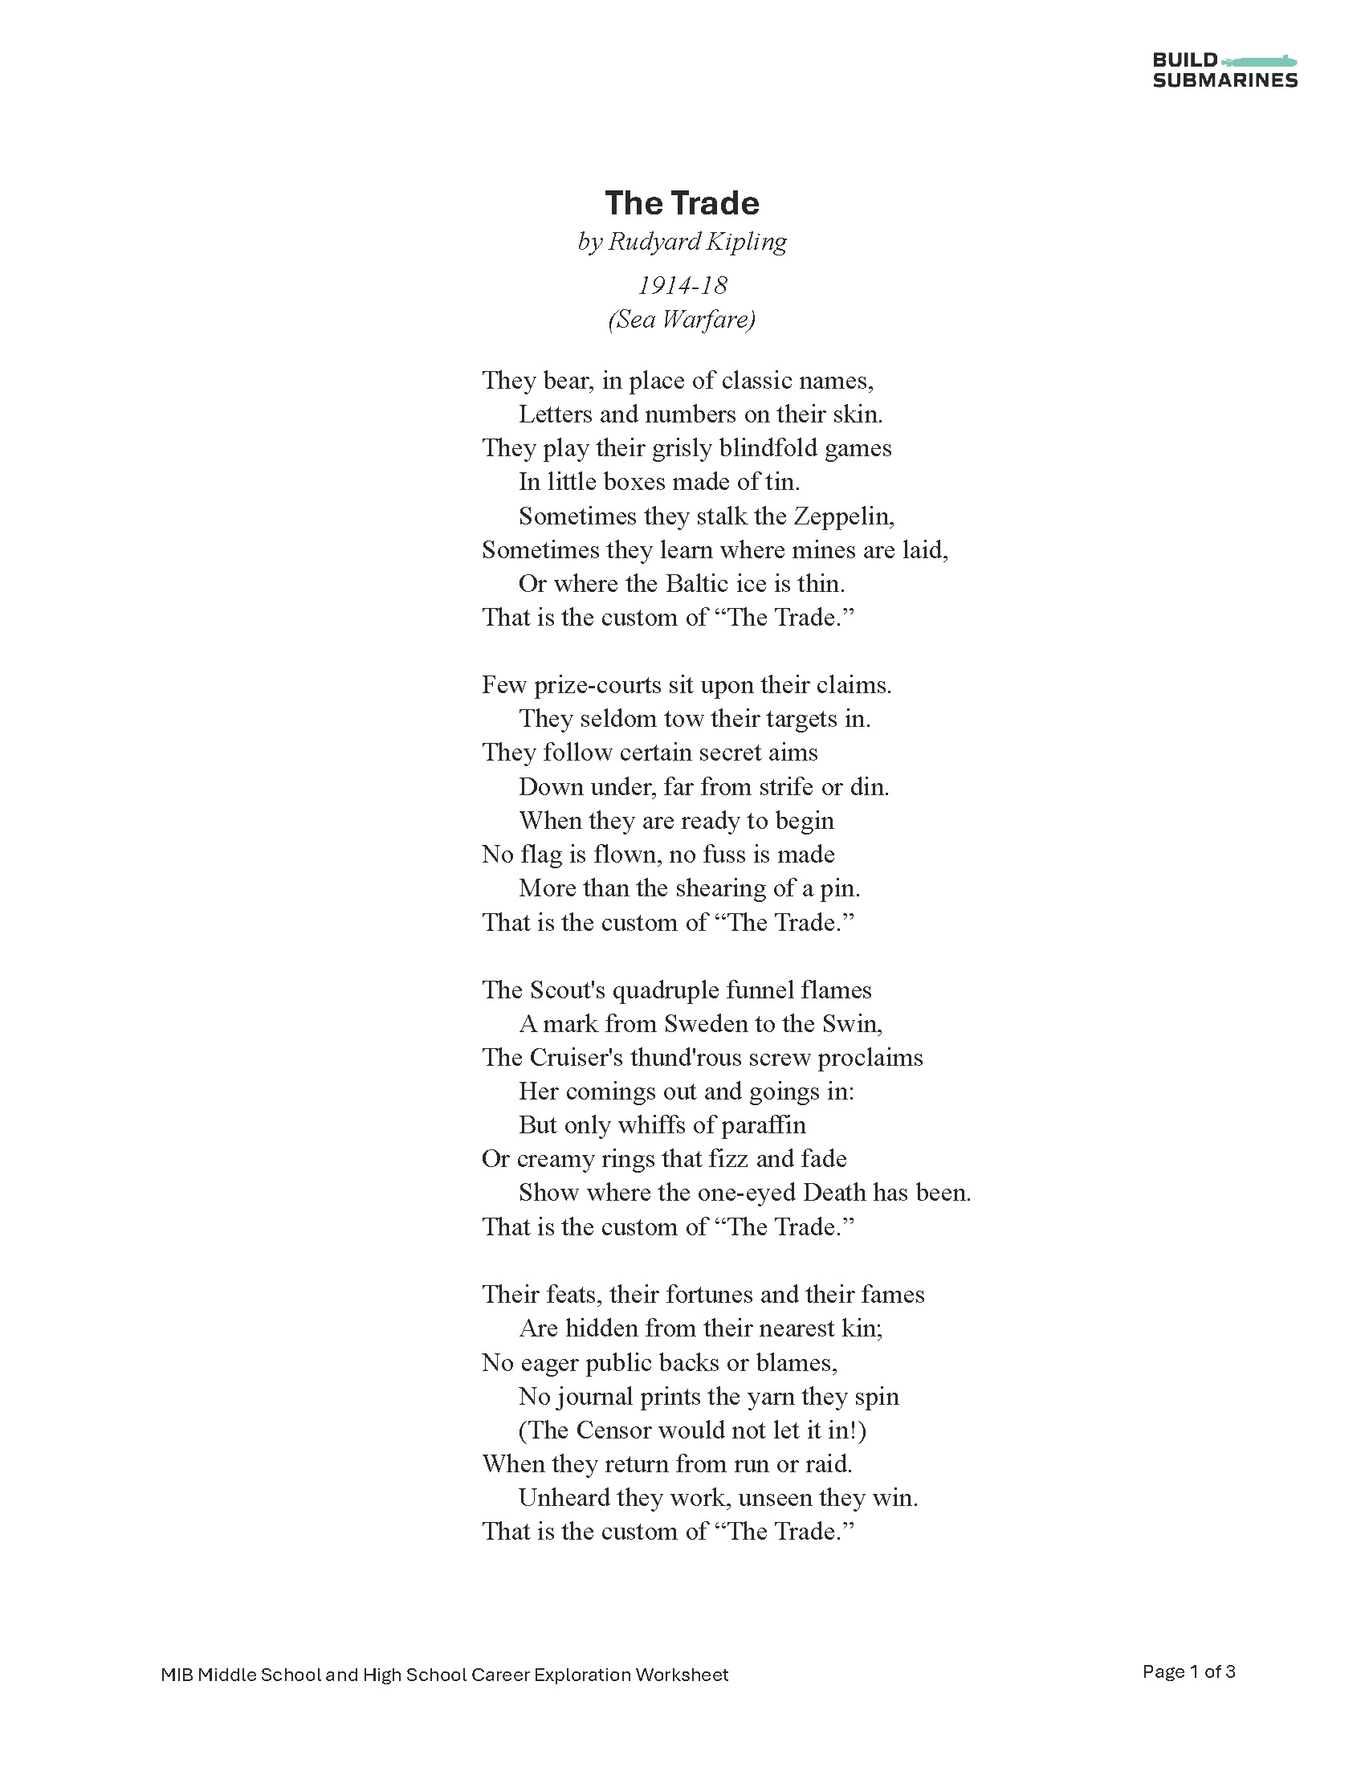
“The Trade” by Rudyard Kipling (c. 1916)
Read the poem provided.
With your partner or group,
finish the following questions:
  What…?
  When…?
  Where…?
  Why…?
  How…?
  Who…?

Slide 9
After reading the poem, why do you think
submarines are
so important?

Slide 10
Visit BuildSubmarines.com/education to access the
Courage Runs Deep video. After watching the video, answer the following questions.
The Courage of a Submariner
How did these recipients show courage?
What do their stories teach us about submarines and their importance?

Slide 11
Back to the mission…
1. Maritime strength IS national security.
2. We MUST rebuild America’s capacity to
manufacture these massive machines.
3. We need YOU to be apart of the submarine
manufacturing workforce.
Want to learn how?

Slide 12
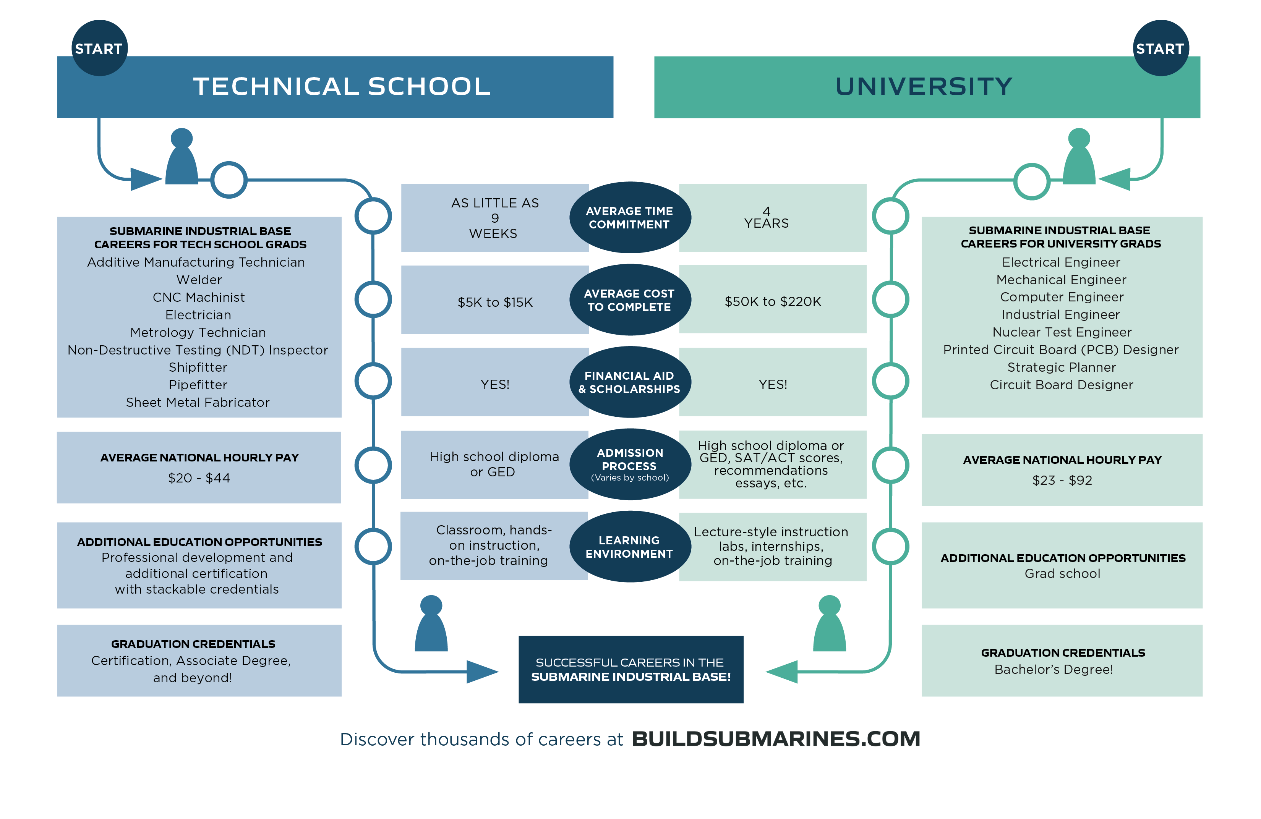
How Can You Support the Mission?
By Joining the Maritime Manufacturing Workforce
Pathways to high-paid, stable careers in the Submarine Industrial Base (SIB)!
How Can You Support the Mission?
By Joining the Maritime Manufacturing Workforce

Slide 13
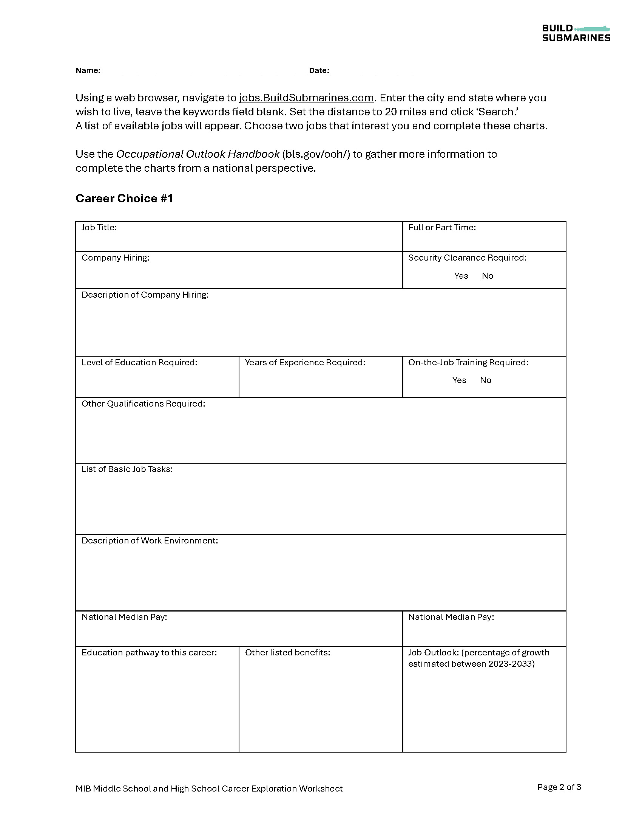
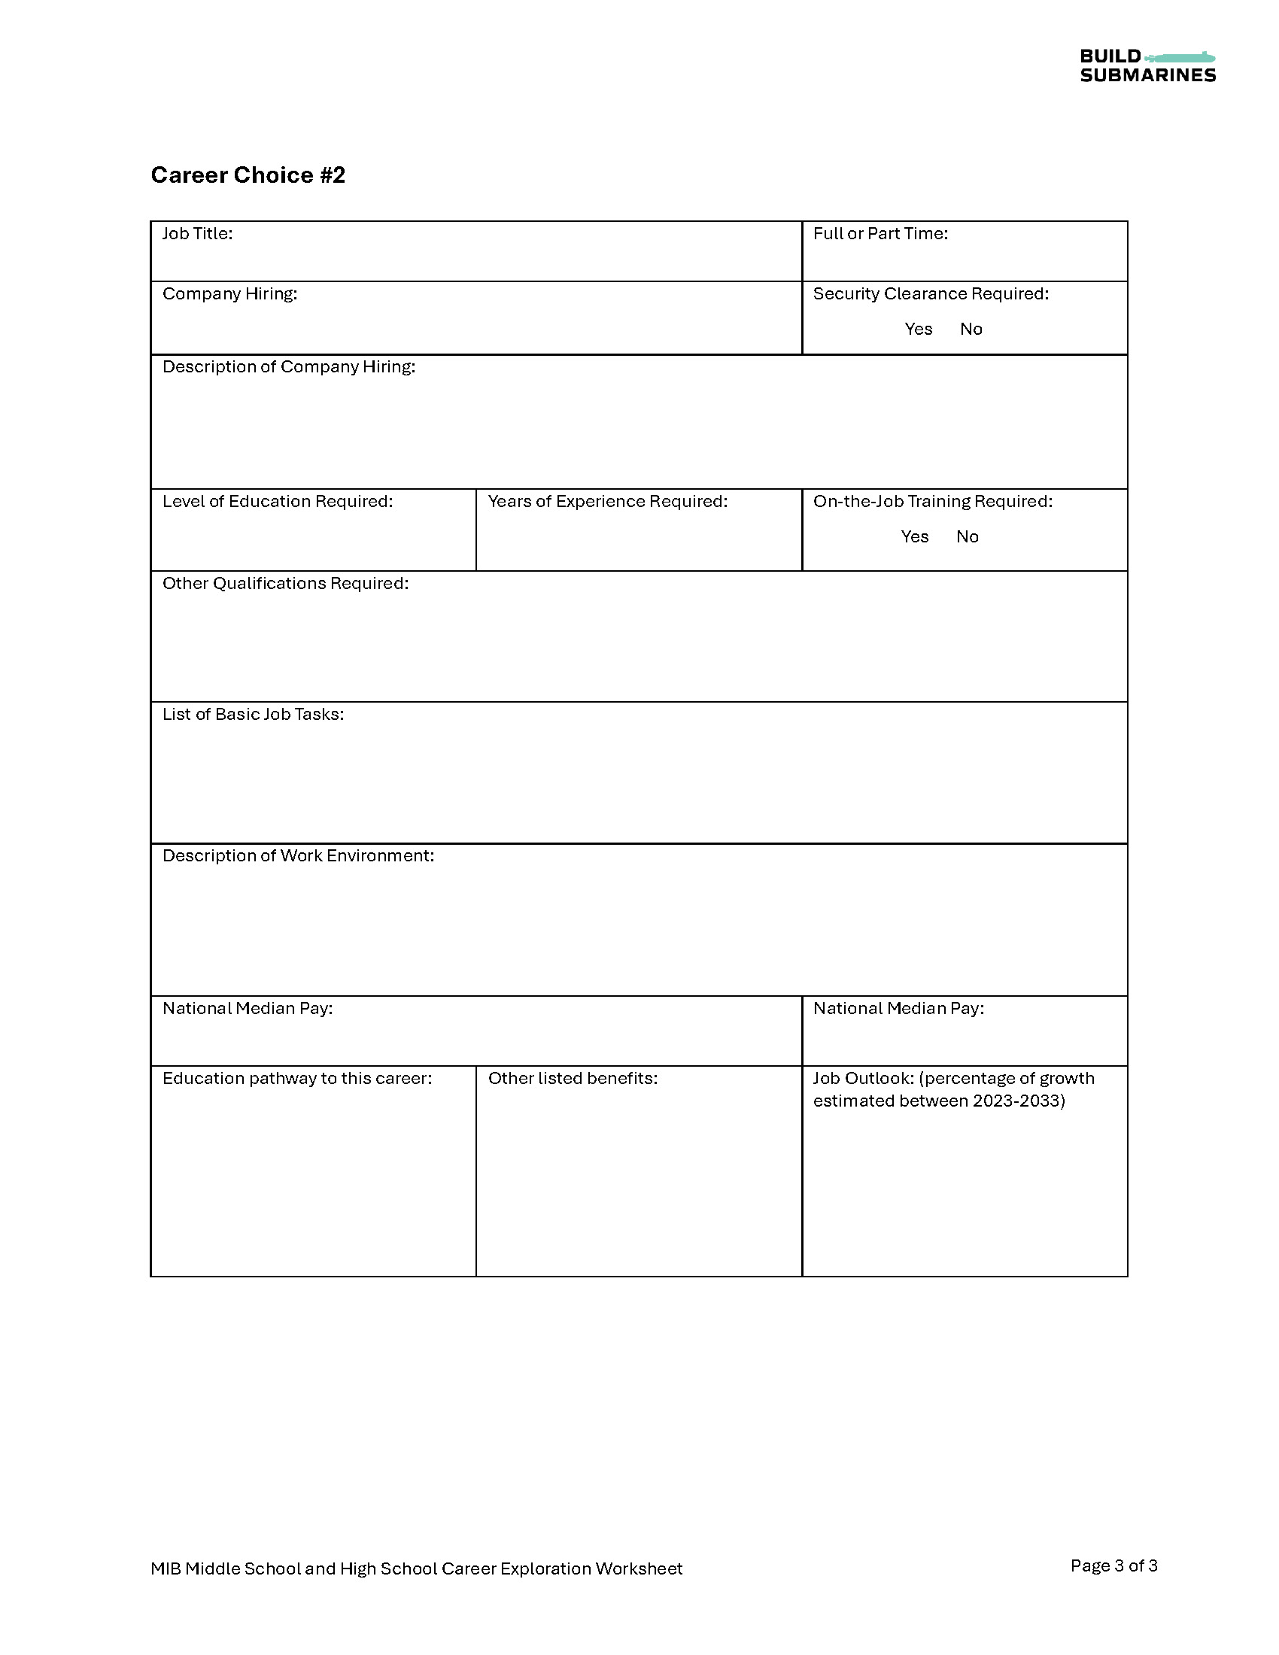
Let’s explore career options within the SIB!
Complete the provided
worksheet by exploring
BuildSubmarines.com

Slide 14
Visit BuildSubmarines.com/education
for more information and classroom resources.

